Slide 1
Virtual reality in the treatment of persecutory delusions: randomised controlled experimental study testing how to reduce delusional conviction
The British Journal of Psychiatry 2016
Impact factor：6.347

Slide 2
Introduction
1. At the heart of persecutory delusions are unfounded threat beliefs.
2. A number of experimental studies have found that dropping safety behaviours leads to greater reductions in the threat beliefs than exposure methods alone.
3. The most common type of safety behaviour is avoidance, patients often try to minimise the number of times that they go outside the home and take steps to decrease their visibility, enhance their vigilance and look out for escape routes.
4. Patients need to test out the persecutory threat beliefs by entering the feared situations and not using safety seeking behaviours, but many patients with persecutory delusions find it too difficult because of the intolerable anxiety generated.

Slide 3
Introduction
6. The solution we have been developing is to use virtual reality.
7. An immersive virtual reality system creates a surrounding three dimensional computer-generated world in which a person can physically move and interact with objects and virtual people.

Slide 4
Method
1. Participants
  (1) Thirty patients with persecutory delusions from adult mental health services in Oxford Health NHS Foundation Trust.
  (2) Inclusion criteria:
    (a) A current persecutory delusion as defined by Freeman & Garety
    (b) The delusion held with at least 50% conviction
    (c) A case-note diagnosis of non-affective psychosis
    (d) Reporting feeling threatened when around other people and using within-situation safety behaviours
  (2) Exclusion criteria:
    (a) A primary diagnosis of alcohol or substance dependency
    (b) Intellectual disability
    (c) Photosensitive epilepsy(光敏性癫痫)

Slide 5
Method
2. Virtual reality system
  (1) Hardware:head-mounted display (HMD), computer
  (2) Virtual reality environments
    (a) Underground train: from no avatars being present to 22 being in the carriage.
    (b) Lift: from two avatars being in the lift to there being six.

Slide 6
Method
3. Design
  (1) Virtual reality exposure therapy
    (a) Use any strategies such as [add person’s safety behaviours].
  (2) Virtual reality cognitive therapy
    (a) You need to learn what happens if you don’t [add person’s safety behaviours], this is the way to find out you are truly safe.
    (b) Instead of [add person’s safety behaviours] you could try something quite different, almost the opposite.
  (3) Real-life social environment => Seven brief periods in virtual reality => Real-life social environment

Slide 7
Method
3. Outcomes
  (1) Before the testing
    (a) Positive and Negative Syndrome Scale (PANSS)
    (b) Psychotic Symptoms Rating Scale(PSYRATS)
    (c) Safety Behaviours Questionnaire
    (d) Beck Anxiety Inventor
    (e) Beck Depression Inventory
  (2) Movement data were recorded for the underground scenarios.

Slide 8
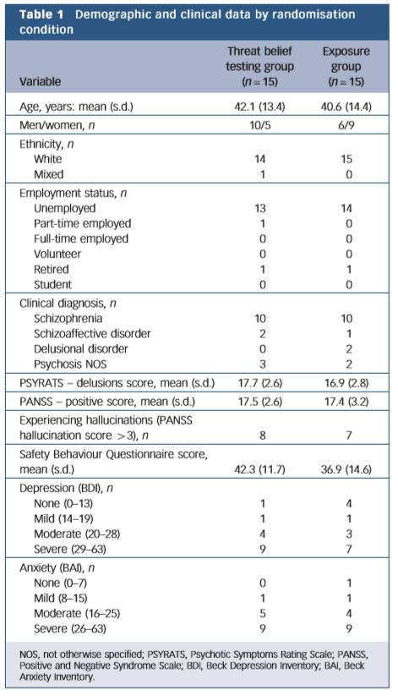

Slide 9
Methods
3. Outcomes
  (3) Visual analogue scale
    (a) How strongly do you believe your persecutory belief?(Conviction)
    (b) How convinced are you that your worries are true?(Conviction)
    (c) How distressed do you feel about your worries?(Distress)
    (d) How distressed did you feel going outside?(Distress)
    (e) How distressed did you feel in the virtual reality scenario? (VR)
    (f) How much do you believe that this will help to reduce your fears about others?(VR)

Slide 10
Results
1. There was no significant difference in movement between the two groups in the empty carriage, but an additional 10.5 metres movement in the final virtual reality underground level by the threat belief testing group compared with the exposure group.
2. A gradual reduction across the scenarios for the threat belief testing group can be seen, whereas the conviction scores remain stable in the exposure group.
3. A gradual reduction in the threat belief testing group and relative stability in the exposure group.
4. Virtual reality cognitive therapy led to a reduction in distress in the real-world situation of 19.6%.

Slide 11
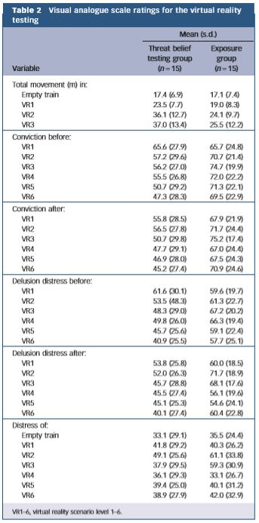

Slide 12
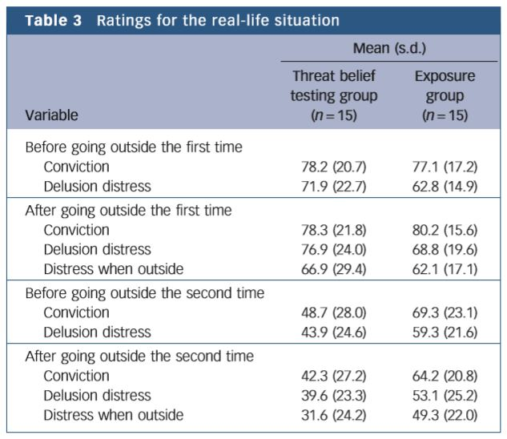

Slide 13
Conclusion
1. Virtual reality can be used to present computerised versions of commonly feared situations to patients with persecutory delusions.
2. New learning can then take place in Virtual reality, and, importantly, that the learning transfers into the real world.

Slide 14
Limitations
1. We did not determine whether there were benefits associated with the exposure condition.
2. Neither the patients nor the researchers were masked to the randomisation allocations.
3. We could only test the effects of encouraging the dropping of safety behaviours.

